Slide 1



Digital Soil Mapping in R
Video 3 –Introduction to Spatial Data and Digital Soil Mapping
Isabel Luotto

Slide 2

Table of contents:
What is Spatial Data?
Spatial Phenomena
Spatial Data Models
Introduction to QGIS
Vector Data in QGIS
Raster Data in QGIS
Raster vs Vector
Projections and Coordinate Systems
Soil observations data in QGIS
Digital Soil Mapping (DSM) Concept
Digital Soil Mapping (DSM) Workflow

Slide 3
What is spatial data?
Spatial data (geospatial data, geographic information) it is the data or information that identifies the geographic location of features and boundaries on Earth
Spatial data is stored with coordinates to describe location;
Maps are a representation of the spatial data;
Spatial data is often accessed, manipulated or analyzed through Geographic Information Systems (GIS).

Slide 4
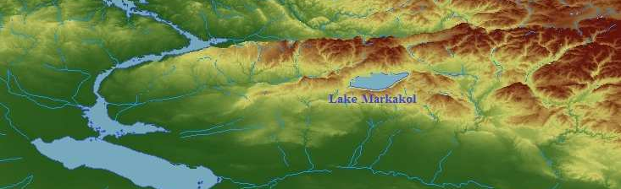
Spatial phenomena
Spatial phenomena can generally be thought of as either :
discrete objects with clear boundaries (e.g. river, road, town)
or as a continuous phenomenon that can be observed everywhere, but does not have natural boundaries (e.g. elevation, temperature, and air quality).
A lake is a discrete object:
it has clear boundaries
Elevation is a continuous phenomena: it exists in every point

Slide 5
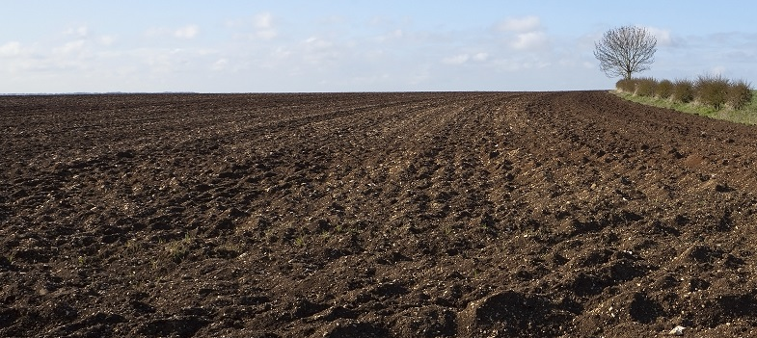
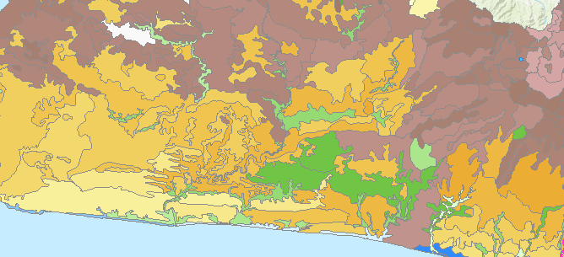
Spatial phenomena
Soil is a continuous phenomenon. It covers almost all land surface.
However we classify soils into discrete soil types that have boundaries

Slide 6
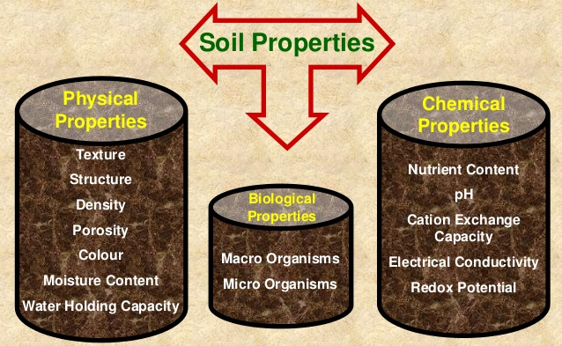
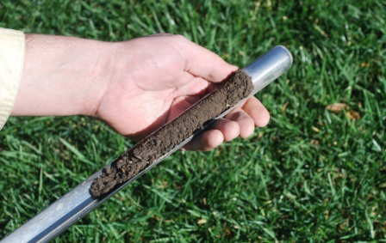
Spatial phenomena
Most of the soil properties are continuous. They exist in every point of the soil.
Soil measurements are discrete. We sample soil and measure soil properties in discrete locations.

Slide 7
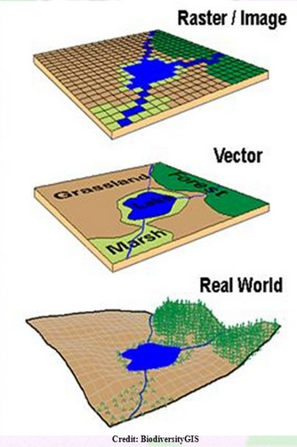
Spatial Data Models
There are 2 ways to represent spatial data: Vector and Raster
Vector model:
Objects, represented as points, lines and polygons
Good for storing discrete data
Raster model:
Surface divided into a regular grid of cells (pixels)
Can be used both for storing discrete and continuous data

Slide 8
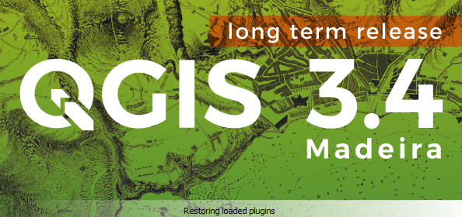
Introduction QGIS
Now, let’s see how spatial soil data works GIS!

Slide 9
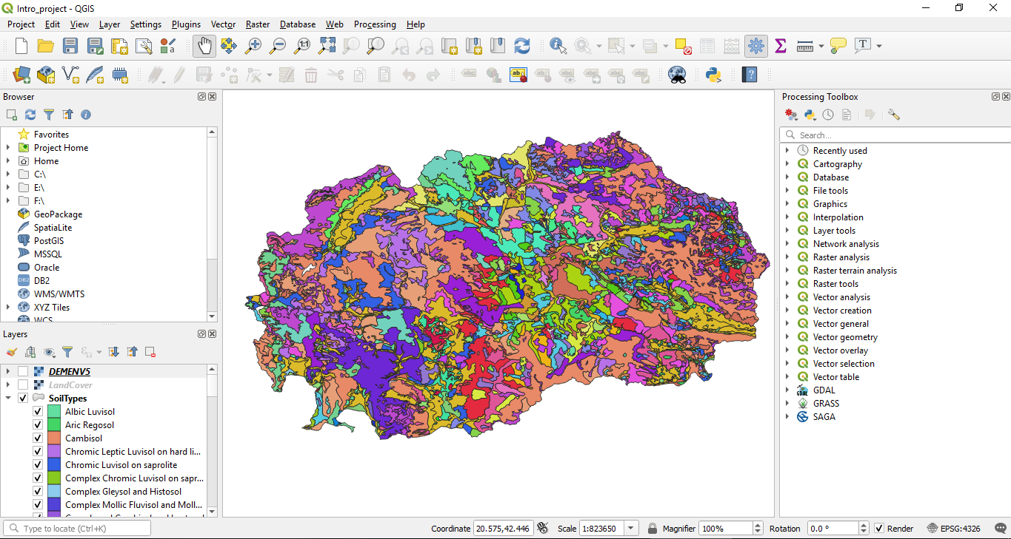

Basic Tools
Main window
Data Processing
Layers window
Try to Zoom-in and Zoom-out
Using the mouse wheel

Slide 10
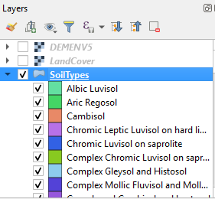
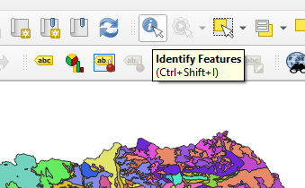
Vector data
Click on the SoilTypes layer to select it.
Then select Identify Features tool

Slide 11
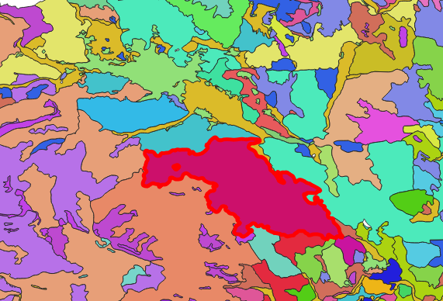
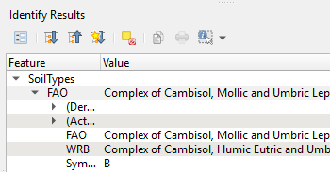
Vector data
Now, click on the map to select any soil polygon;
On the right, a new window will appear, representing attributes of the selected polygon.
This is Vector data type.
In vector data, every feature is a discrete object that has attributes (e.g. names soil types).

Slide 12
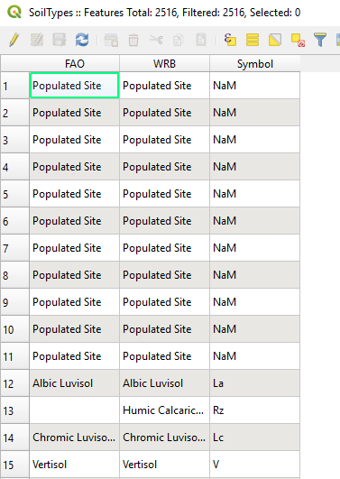
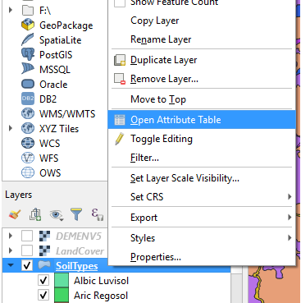
Attribute table
Right click on the SoilTypes layer
Open Attribute table

Slide 13
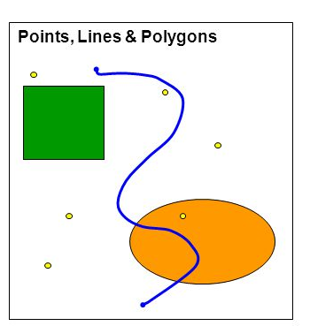
Vector data
Key characteristics of Vector data:
Discrete spatial objects: points, lines or polygons
Attribute table attached to spatial objects
Common Vector data formats: shapefile (.shp)
Advantages of Vector data:
Good for storing discrete data (e.g. points)
High geographic accuracy of points and boundaries
Disadvantages of Vector data:
Continuous data is poorly stored (needs classification)
Hard to make calculations with multiple layers

Slide 14
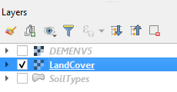
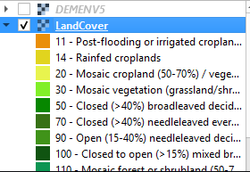
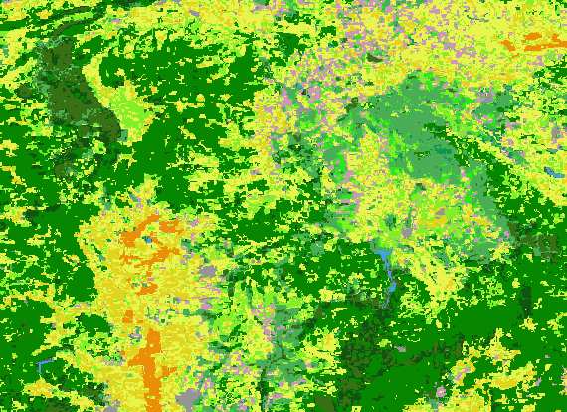
Discrete raster data (categorical)
Now, deselect polygon by clicking on white space
Switch off SoilTypes in the Layers window, and switch on LandCover
Expand the legend by clicking on a black triangle
Explore the Land cover map

Slide 15
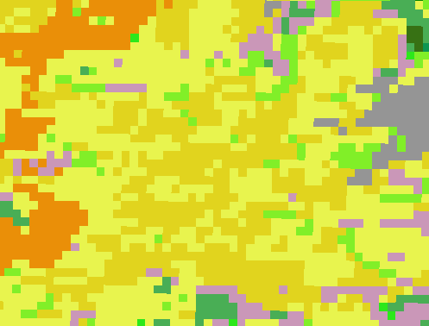
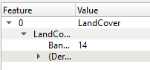
Discrete raster data (categorical)
Zoom-in to see that the image consists of rectangular pixels (raster cells);
Click on the image to see values;
There is no attribute table only single value in each raster cell
These values are not real numbers, but coded categories
You can see the meaning of each coded category in the legend, e.g:
14 - Rainfed croplands

Slide 16
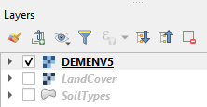
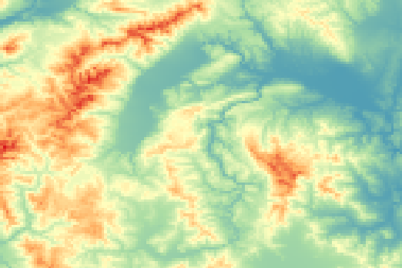
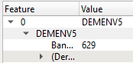
Continuous raster data
Zoom-out, switch off LandCover, and switch on DEMENV5 layer
This is a digital elevation model
Click on different parts of the map to see the values
Value of each cell represents real elevation (altitude) in meters above sea level.

Slide 17
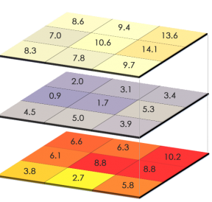
Raster data
Key characteristics of Raster data:
A regular grid of cells (pixels) with a value in each cell
Raster resolution defines cell size and accuracy
Higher resolution = smaller cell size = better quality
Common Raster data formats: GeoTiff (.tif, .tiff);
Advantages of Raster data:
Can store discrete data (categories) and continuous data (values)
Calculations with multiple rasters is quick and easy to perform
Disadvantages of Raster data:
Low resolution rasters are not accurate

Slide 18

Raster vs Vector
Questions:
How can you represent soil types: with raster or with vector?
Which way is better?
How can you represent soil properties (e.g. Carbon, pH, texture): with raster or with vector?
Which way is better?

Slide 19
Raster vs Vector
Answers:
Soil types can be represented both as a Vector
(soil polygons) or as a Discrete Raster;
Vector format is better for accurate representation of polygons;
Soil properties can be represented both as a Vector (attributes of soil polygons) or a Continuous Raster;
Raster format is better for representing variability of soil properties, calculations and modelling.

Slide 20
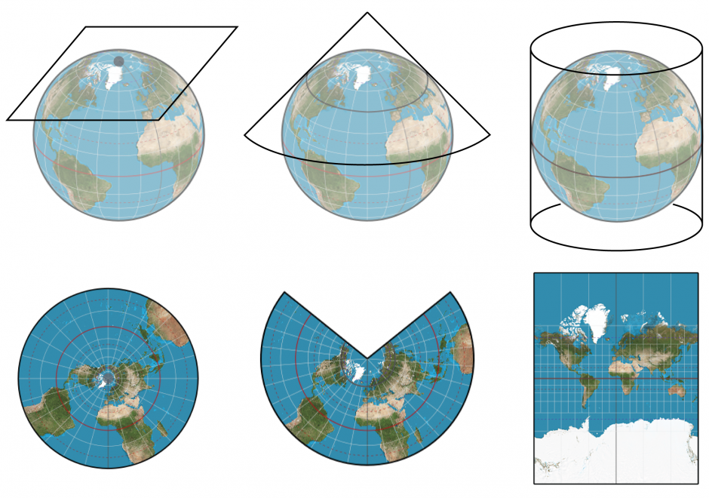
Map projections
All spatial data are displayed using a certain projection
All projections of a sphere on a plane cause surface distortions
Depending on the purpose of the map different map projections exist in order to preserve some properties

Slide 21
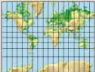
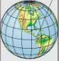
Coordinate Reference Systems (CRS)
Coordinate Reference System (CRS) is an essential property of spatial data: it defines, how coordinates of our data are stored.
2 types of CRS:
Geographic:
Coordinates are stored as latitude and longitude - in degrees
Good for storing data (independently of projection)
Cannot be used for spatial calculations (e.g. distance, area)
e.g. WGS 84 (EPSG:4326)
Projected:
Coordinates are stored according to a projection - in meters
Can be used for spatial calculations (e.g. distance, area)
Knowledge of the exact CRS is required to interpret the data
e.g. UTM zone 48S (EPSG:32748)
Information on EPSG codes: http://www.spatialreference.org

Slide 22
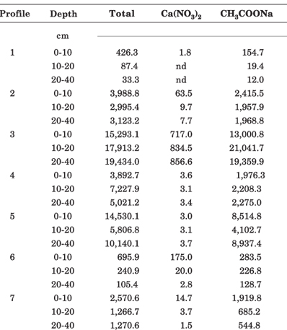
Soil observations
What about data of soil observations (soil profiles, surface sampling)?
Usually, data of soil observations are stored as a table (xlsx, csv)
When a table has coordinates (X, Y), it can be converted into Vector data type - Points.

Slide 23
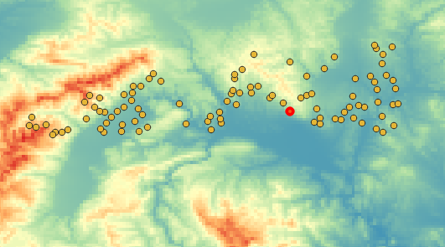
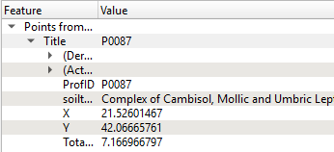
Point data (soil observations)
You can explore a new Vector data layer with point observations;
You can select points and see the attributes

Slide 24
Soil properties data
We have:
Discrete soil observations as point data in sampling locations
We need:
Continuous estimation of soil properties in every point of the land surface
Task of the Digital Mapping of Soil Properties:
To predict continuous soil properties in every point of the land surface based on discrete measurements of soil sampling. But how to do it?

Slide 25
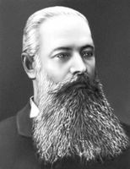


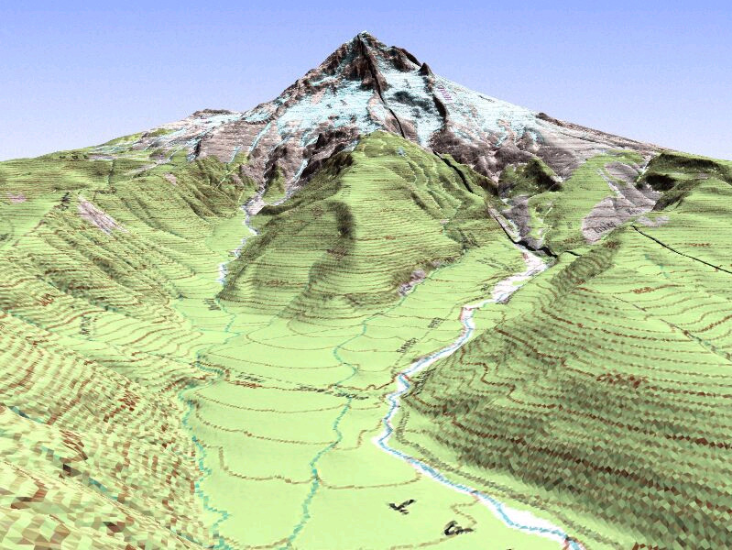
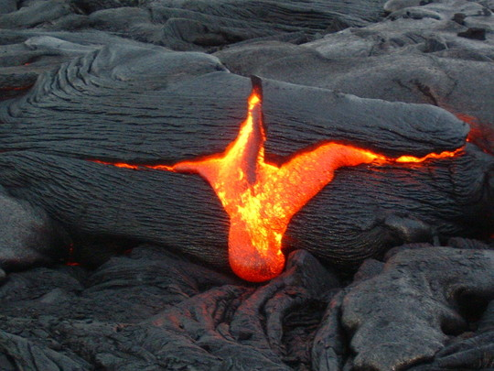

Drivers of soil formation
V. Dokuchaev (1883):
Genesis and evolution of soils is the result of the interaction of a number of environmental parameters:
Climate
Organisms
Parent Material
Relief
Time

Slide 26
Drivers of soil formation
H. JENNY (1941):
Conceptualization of soil as an state equation of soil formation.
Soil and soil properties are a function of a number of environmental parameters named soil forming factors:
S = ƒ(cl, o, r, p, t)
CLORPT MODEL
climate
organisms
relief
parent material
time

Slide 27
Digital Soil Mapping (DSM)
Definition of Digital Soil Mapping (DSM)
The creation and population of spatial soil information systems by numerical models inferring the spatial and temporal variations of soil types and soil properties from soil observations and knowledge and from related environmental variables (Lagacherie and McBratney, 2007).
McBRATNEY, 2012: Conceptualization of forming factors. Soil and soil properties are a function of a number of environmental parameters named soil forming factors:
S = ƒ(s, c, o, r, p, a, n)+ ε
SCORPAN MODEL
soil attribute to predict
soil
properties
climate
organisms
relief
parent
material
age
location
function residuals (errors)

Slide 28
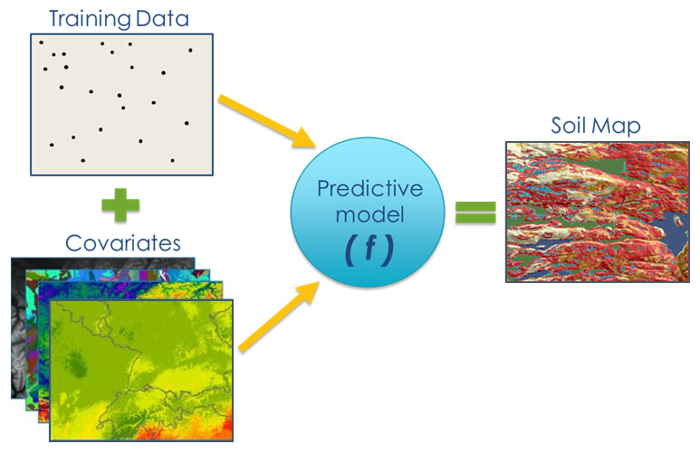
Digital Soil Mapping Workflow
Source: USDA

Slide 29
Digital Soil Mapping Workflow
Steps to Map Soil Properties with DSM approach:
Prepare soil observations (soil profile data);
Prepare environmental covariates (raster layers);
Fit the prediction model using a target soil property (e.g. SOC) as a dependent variable and the covariates as predictors;
Linear modelling;
Geostatistical modelling;
Machine learning;
Map the soil property using the prediction model;
Assess the quality and uncertainty of the map.

Slide 30



